Slide 1
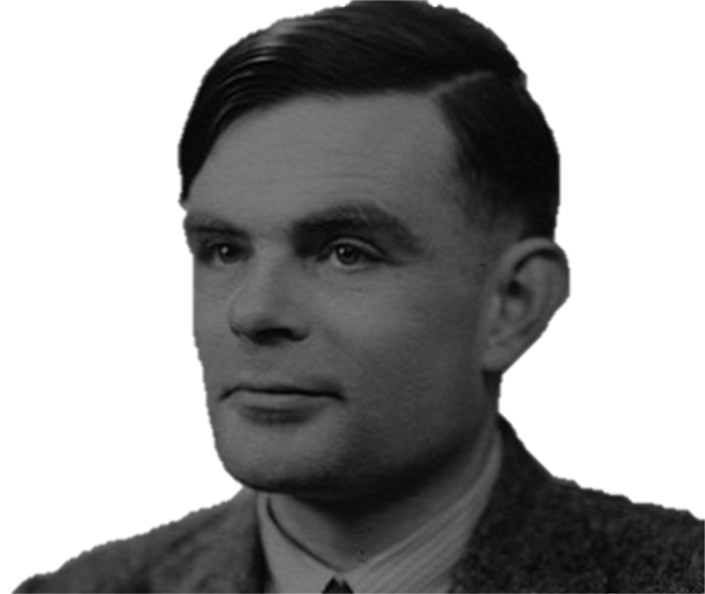


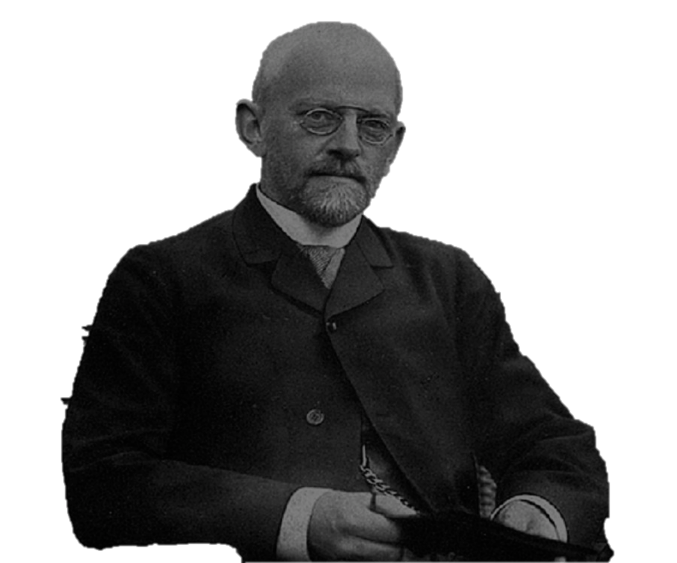
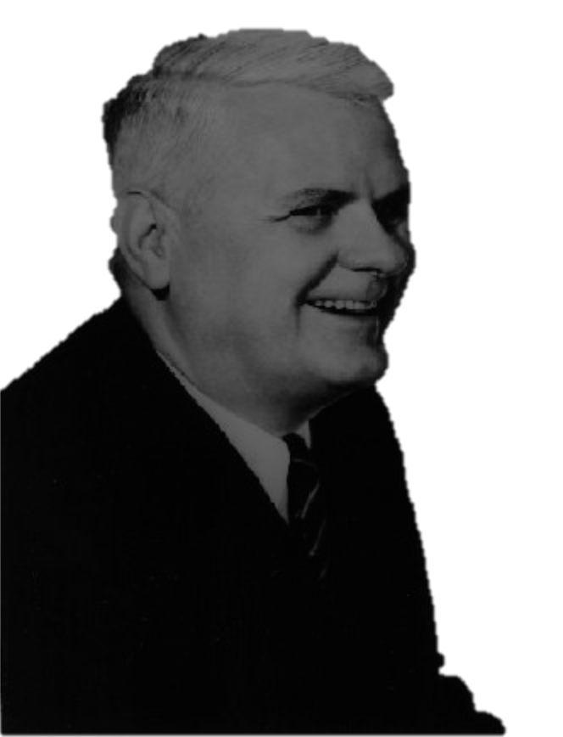
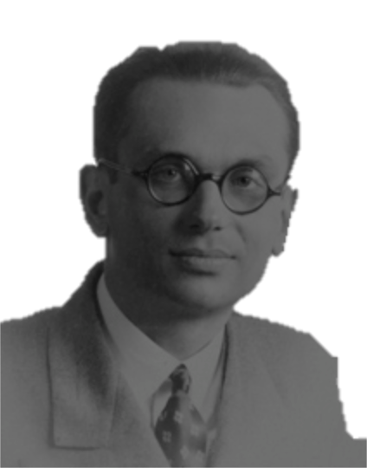
THE TURING MACHINE
Constraints on Computation and the Decidability of Mathematics
1|0|1| |0|1| |0|1|1| |1|1|0| |1|0| |1|0|1|0| |1|0|1| |0|1| |0|1|0|1| |0|1|0| |0|1|0|0|1| |0|1| |0|1|0| |0|1| |1|0
^
by Dilyn Fullerton

Slide 2

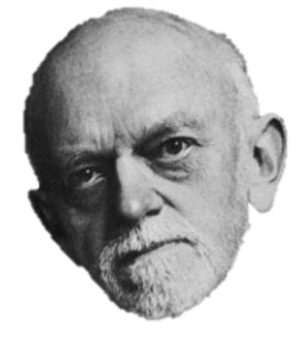
Hilbert’s dream
MATHEMATICS:
Consistent
Complete
Decidable

Slide 3
Formally…

Slide 4
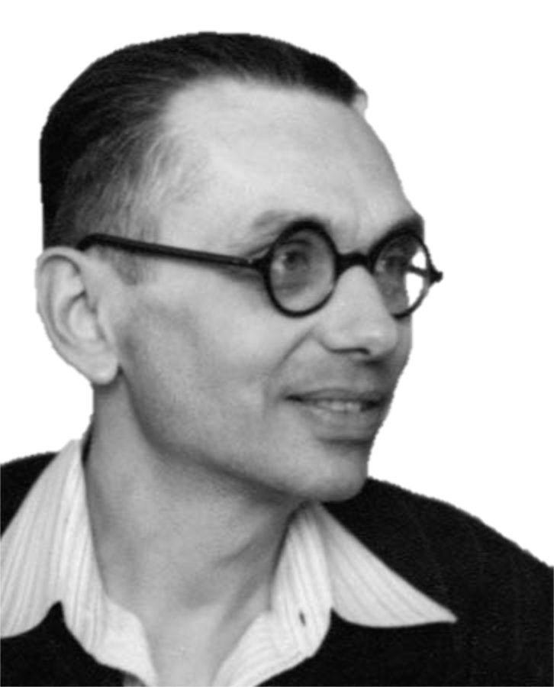
Hilbert’s dream
MATHEMATICS:
Consistent
Complete
Decidable

Slide 5
Problem with the “Decision Problem”
What defines an ‘effective method’?

Slide 6
Alan Turing’s solution:
The Turing Machine: A read/write “head” that moves back and forth on an essentially infinite “tape”
| | | | | | | |1|0|0| |1|0|0| |1| |0| |0|1|0|1|0|1|0| | | | | | | | |

Slide 7
Defining a Turing Machine
A Turing Machine is fully specified by 7 finite and immutable parameters:
States
Initial state
Halting states
Alphabet
Blank
Input alphabet
Transition function

Slide 8
Operation of a Turing Machine
Start in the initial state
Halt if in a halting state
Read the value at current section
State and read value specify next transition (write value, move direction, next state)
Write the write value
Move in the move direction
Enter the next state
Step 2

Slide 9
Example: Negator
Halts with output 1 if given 0, otherwise enters an infinite loop.
# Transition function
<0, 0, 1, R, H>
<0, 1, 1, R, 1>
<0, b, b, R, R>
<1, 0, 0, L, 0>
<1, 1, 1, L, 0>
<1, b, b, L, 0>
# States
{0, 1, H, R}
# Initial state
0
# Final states
{H, R}
# Alphabet
{0, 1, b}
# Blank
b
# Input alphabet
{0, 1}

Slide 10
Example: Negator
Given a 0…
Given a 1…
…

Slide 11
Example: Binary copy
Copies a binary number

Slide 12
Example: Binary copy
Output

Slide 13
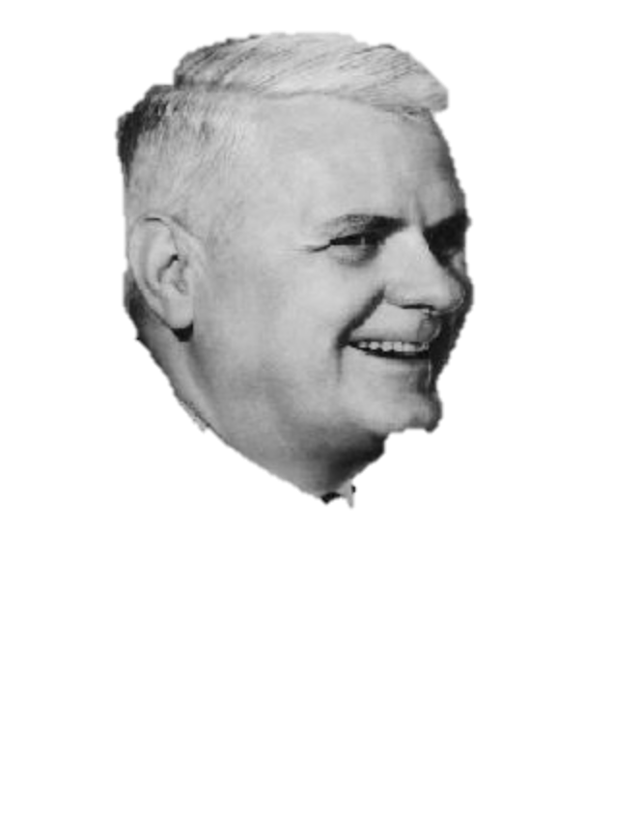

Turing Machines are fundamental
An algorithm is computable if there is a Turing Machine that can decide it in finite time.
My machine can compute anything that is computable!
His machine can compute anything that is computable

Slide 14
Decidability revisited

Slide 15
Universal Turing Machines and the Halting Problem
A Universal Turing Machine is a Turing Machine that takes another Turing Machine as input
Halting Problem: Could there be a UTM that takes an arbitrary Turing Machine and its input and determines whether that machine would halt?

Slide 16
Decidability of the Halting Problem (proof sketch)
H
Turing Machine, M
0, if M will loop forever given T
Input tape, T
1, if M will halt given T
H will always resolve the Halting Problem

Slide 17
Decidability of the Halting Problem (proof sketch)
X
P
X
H
N
X
X
?
X
CASE I: H returns 0 (“X will not halt”), then N (and thus X) halts. Contradiction.
CASE II: H returns 1 (“X will halt”), then N loops forever. Contradiction.
CONCLUSION: H cannot exist. The Halting Problem is undecidable.

Slide 18
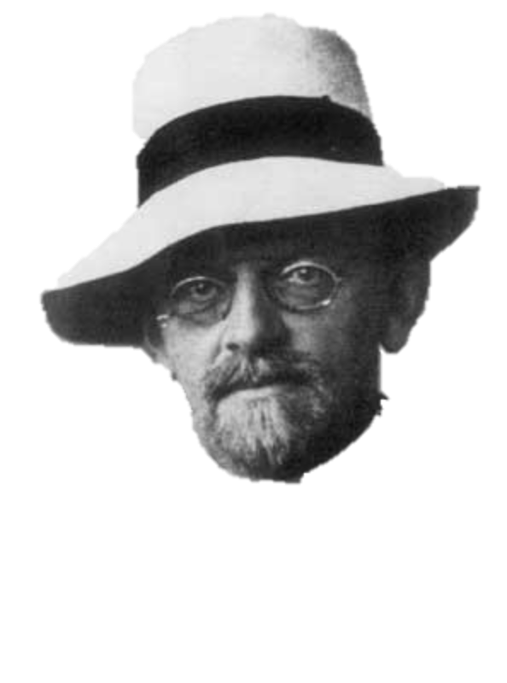

Conclusion: Hilbert is very sad
MATHEMATICS:
Consistent
Complete
Decidable

Slide 19
One more thing…
…okay maybe two

Slide 20
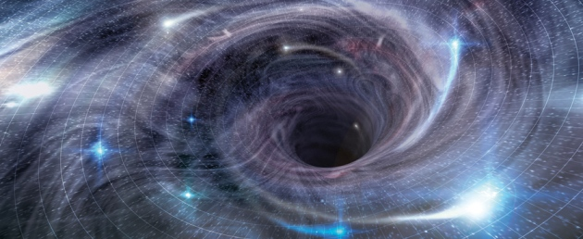

Digital physics and information
Is our whole universe a simulation (or nested simulation) on a Universal Turing Machine?

Slide 21
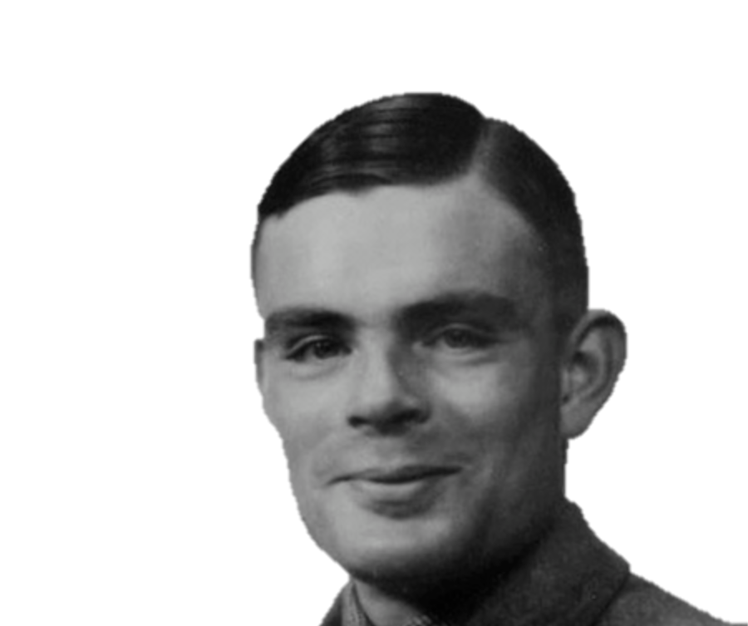
Get creative
The most profound problems are often solved by people who approach them in their own creative and unconventional ways

Slide 22
Sources
http://plato.stanford.edu/entries/turing-machine/
http://plato.stanford.edu/entries/church-turing/
http://plato.stanford.edu/entries/goedel-incompleteness/
https://math.stanford.edu/~feferman/papers/deciding.pdf
http://www.philocomp.net/home/hilbert.htm
http://www.philocomp.net/home/turing.htm
http://www.dna.caltech.edu/courses/cs129/caltech_restricted/Turing_1936_IBID.pdf
https://www.youtube.com/channel/UC9-y-6csu5WGm29I7JiwpnA
https://youtu.be/GP21wU6R0-o?list=PLslgisHe5tBM8UTCt1f66oMkpmjCblzkt

